Slide 1

Video-Based Continuous Sign Language Gesture Recognition
Supervisor: Arghir Nicolae Moldovan
Research Project
MSc in Data Analytics
Samridh Sharma
Student ID: x17157846

Slide 2
WELCOME
Sign language interpreters are currently required to interpret for speech impaired people.
Their job is extremely cumbersome and as a result the number of interpreters per capita across majority countries is very low.

Slide 3
INTRODUCTION
According to research about 68 million people in the world suffer from speech impairment or hearing loss.
Instead of relying on human interpreters which are sparse in population a more pragmatic approach is to rely on technology, computer vision based approach.
250
Certified Sign language Interpreters in India
Sunavala, N. (2019). The fight to make Indian Sign Language official - Times of India ►. [online] The Times of India. Available at: https://timesofindia.indiatimes.com/home/sunday-times/the-fight-to-make-indian-sign-language-official/articleshow/66101577

Slide 4
RESEARCH QUESTION
how to recognise a Continuous Argentina Sign Language gesture using a modified Inception V3 with a LSTM Recurrent Neural Network
Two approaches are followed in our research.

Slide 5
WHERE WE ARE GOING
MOTIVATION
RELATED WORK
CURRENT WORK
The motivation behind this research is to classify and recognise continuous sign language gestures based on machine vision. This in turn will assist people that are affected by speech and hearing impairment in understanding, translating and recognising sign gestures.
From a research point of view, if a robust sign language recognizer, translator and interpreter using the computer vision is built then the mute population will be benefitted by it .
The territory of sign language recognition is not new, there has been some work already done. On Irish static image dataset consisting of 50,000 image a research was conducted which established a marginal prominence of End-to-end approach over feature based approach (Chatbri et al., 2018). Potential research papers in image classification domain insisted on the need to employ a pre-trained model like VGG-16, Xception, Inception V3 model for the purpose of accurate classification. CNN into a HMM embedding where the output of CNN is interpreted in an unorthodox Baysian fashion (Koller, 2015). However, This sub-division of spatiotemporal gestures of detecting and translating continuous signs and gestures is the most challenging and difficult to contemplate and orchestrate (Koller et al., 2016). .
Currently researchers are working to transform from sign language recognizer to sign language localizer.
Researchers are also working on combining the concepts of NLP to make a fully functional vision-based sign language translator.

Slide 6











DATA SELECTION
PRE-PROCESSING
METHODOLOGY
.
DATA TRANSFORMATION
KDD is the applied methodology in this research.
DATA MINING
INTERPRETATION/EVALUATION

Slide 7
DESIGN
AND
IMPLEMENTATION
Data Preparation and Pre-processing
SoftMax Approach
Global Max Pooling Approach
Implementation Design

Slide 8
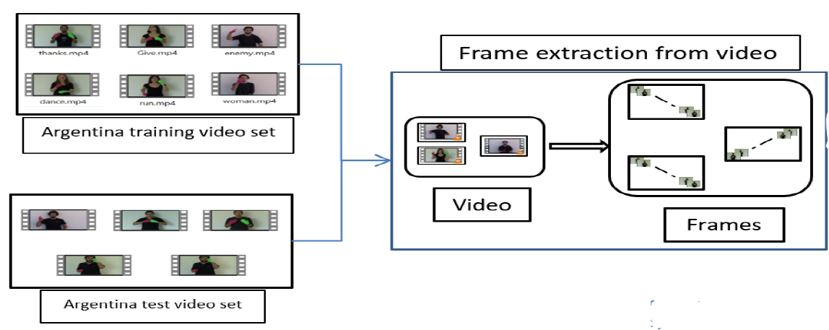
Data Preparation and Pre-Processing
LSA ARGENTINA SIGN LANGUAGE VIDEO DATASET
64
Total number of Continuous Sign gestures
10
Sign Language Performers
3200
Total Number of Videos
1920*1080
Pixel size
LSA: An Argentinian Sign Language Dataset’, Congreso Argentino de Ciencias de la Computacion (CACIC), pp. 794–803.
Gygli, Michael. Ridiculously Fast Shot Boundary Detection with Fully Convolutional Neural Networks. arXiv May 2017

Slide 9
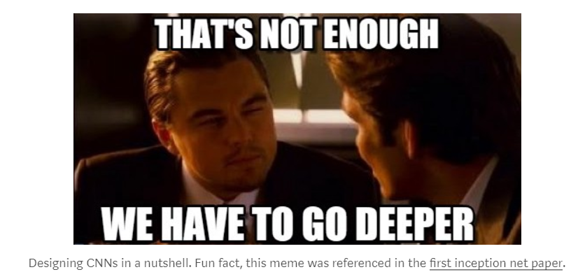

Slide 10
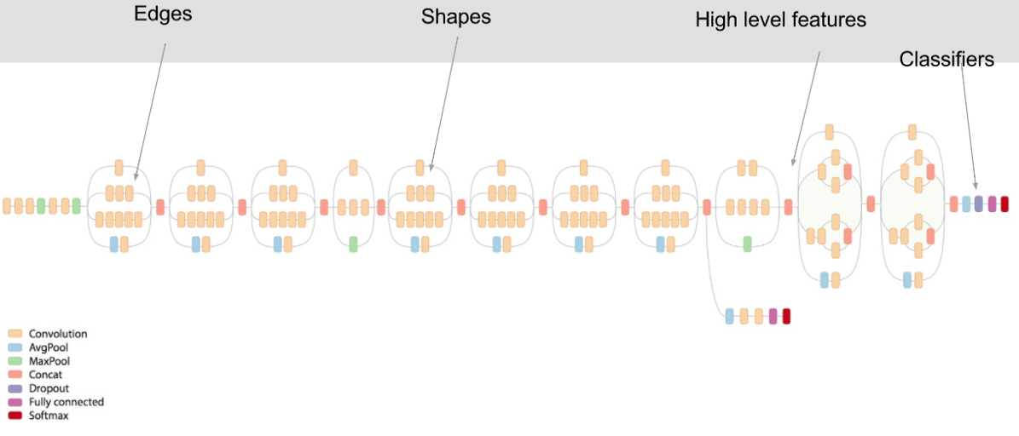

Inception V3 Architecture
22
Layers with weights
Each layer is a different Level of abstraction
Most Efficient
ILSVRC’14
Classifier (Alfredo Canziani, Adam Paszke, Eugenio Culurciello, 2017)
Classification winner
Lecture 9: Fei-Fei hi & Justin Johnson : CNN architectures
An Analysis of Deep Neural Network Models for Practical Applications

Slide 11
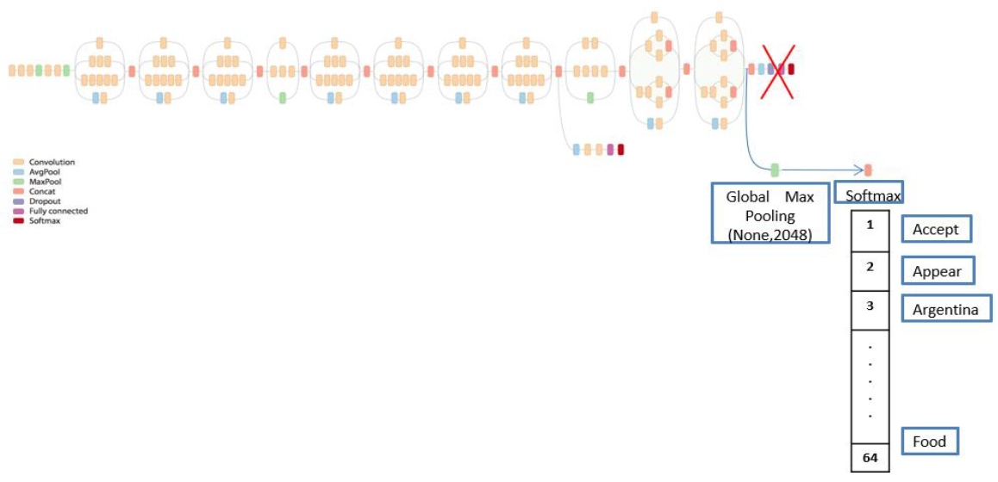
SoftMax Approach (Modification of Inception V3)
SoftMax Layer Contains label prediction of each Frame
Where (None) is indication of arbitrary batch size
Lecture 9: Fei-Fei hi & Justin Johnson : CNN architectures
Rathi, D., 2018. Optimization of Transfer Learning for Sign Language Recognition Targeting Mobile Platform. arXiv preprint arXiv:1805.06618.

Slide 12
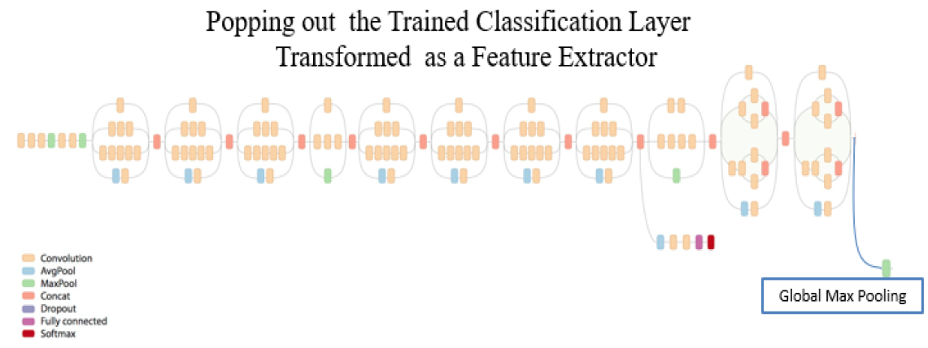
Global Max Pooling Approach
Transforming Modified Inception V3 into Feature Extractor
Transforming Modified Inception V3 into Feature Extractor

Slide 13
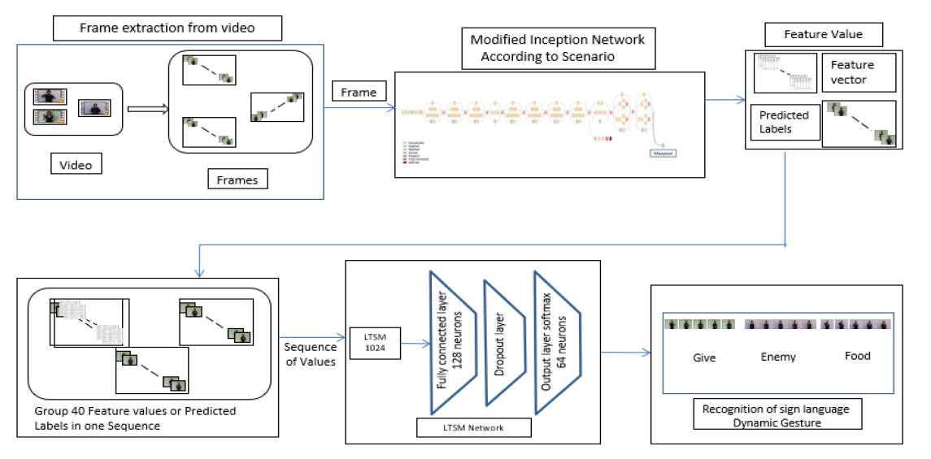
IMPLEMENTATION DESIGN

Slide 14
EVALUALTION
EXPERIMENT 1 : TRAINING WITH 80% OF VIDEOS
EXPERIMENT 2 : TRAINING WITH 50% OF VIDEOS
EXPERIMENT 3 : TRAINING WITH 20% OF VIDEOS

Slide 15
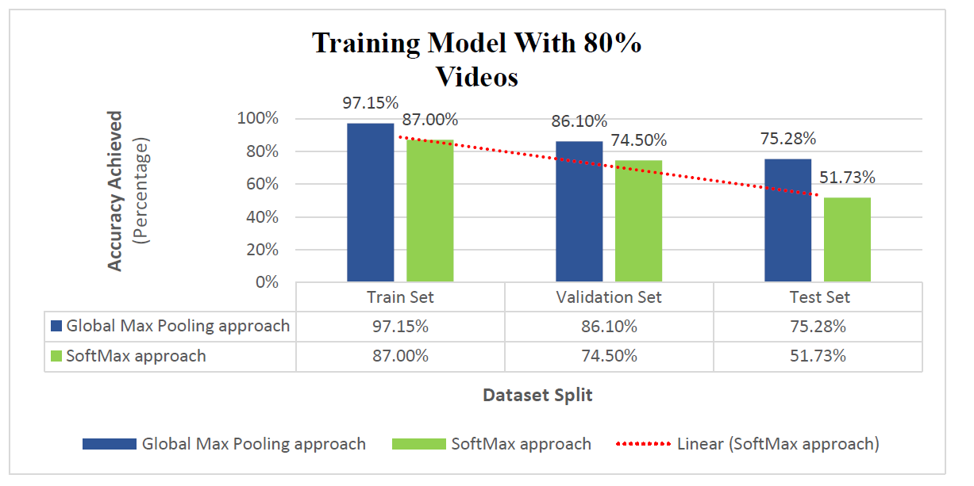
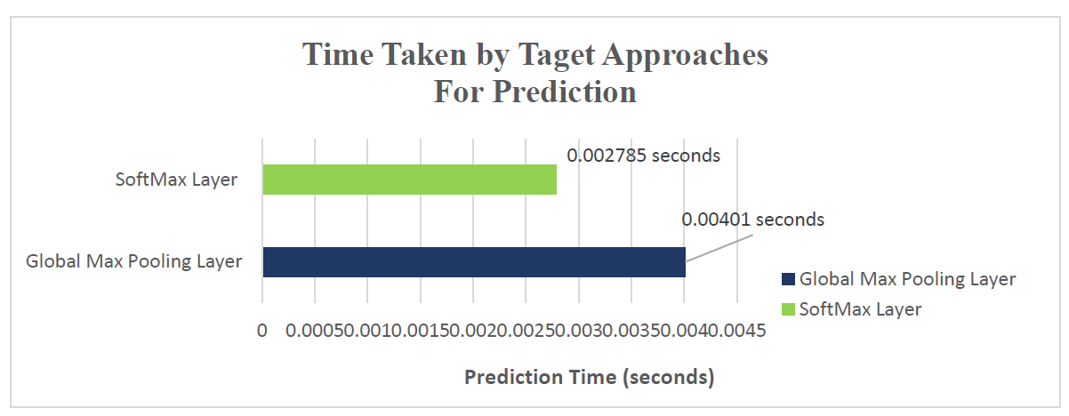
EXPERIMENT 1 : TRAINING WITH 80% OF VIDEOS

Slide 16
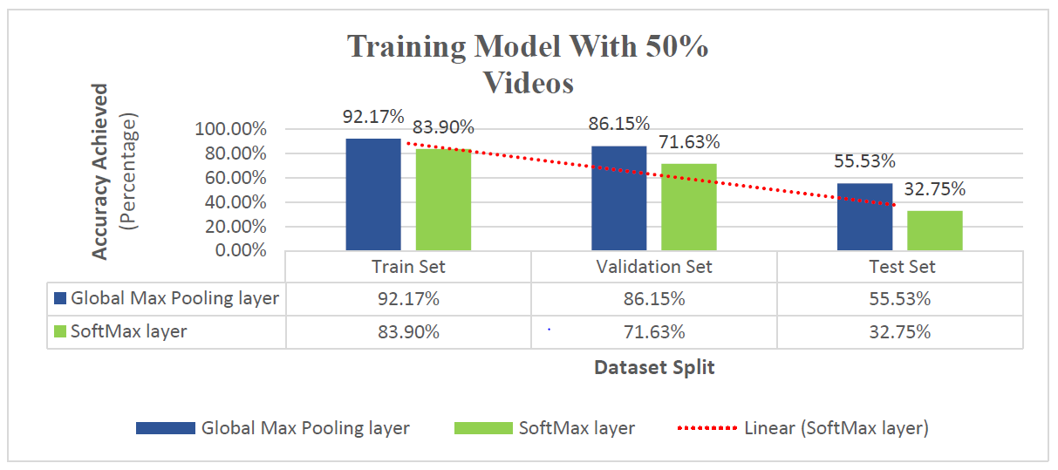
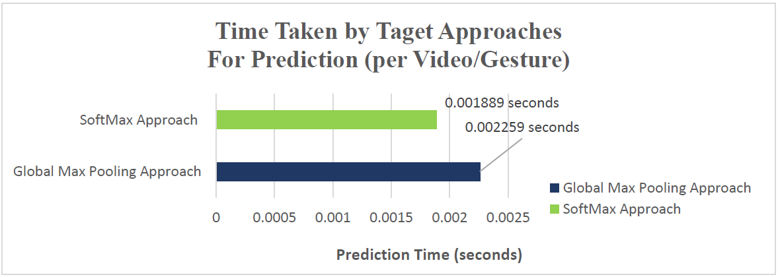
EXPERIMENT 2 : TRAINING WITH 50% OF VIDEOS

Slide 17
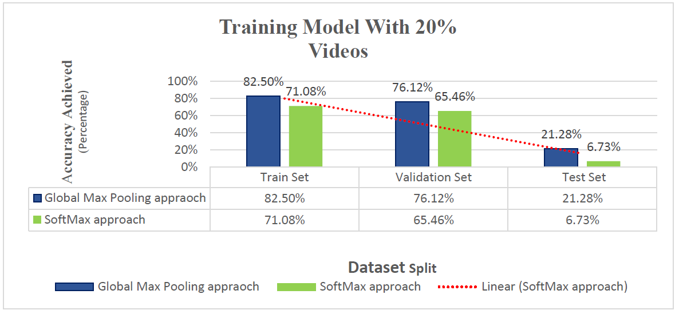
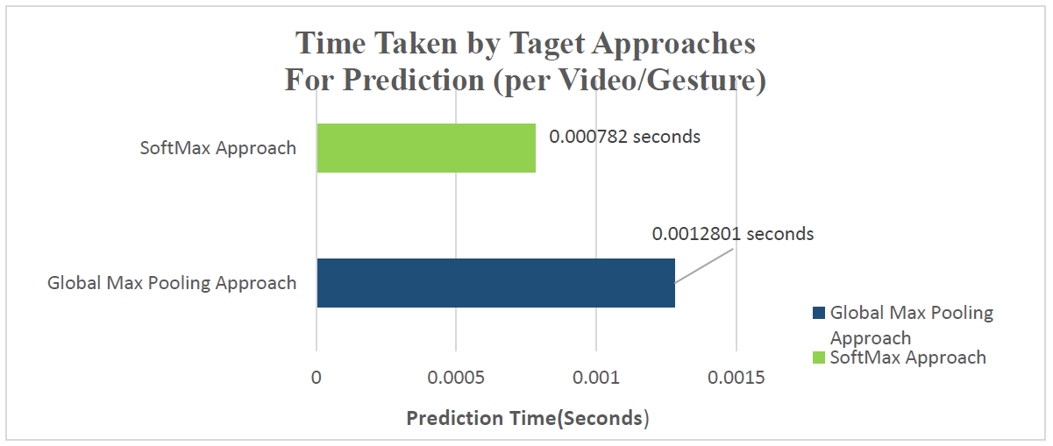
EXPERIMENT 3 : TRAINING WITH 20% OF VIDEOS

Slide 18
CONCLUSION AND FUTURE WORKS
CONCLUSION
Global Max Pooling approach outperformed SoftMax approach with optimal parameter when trained on 80% of the videos. Model accuracy achieved on the validation set is 86.10% and on the test set is 75.2%.
In our approach where we modify the inception model as a feature extractor for LSTM RNN works dramatically better than employing it for examination of the temporal dependencies of the generated probabilities.
FUTURE WORKS
This research can further be extended by finding ways to transform a recognizer into a localizer.
The concepts of NLP can also be amalgamed to develop a fully functional vision-based sign language translator.

Slide 19
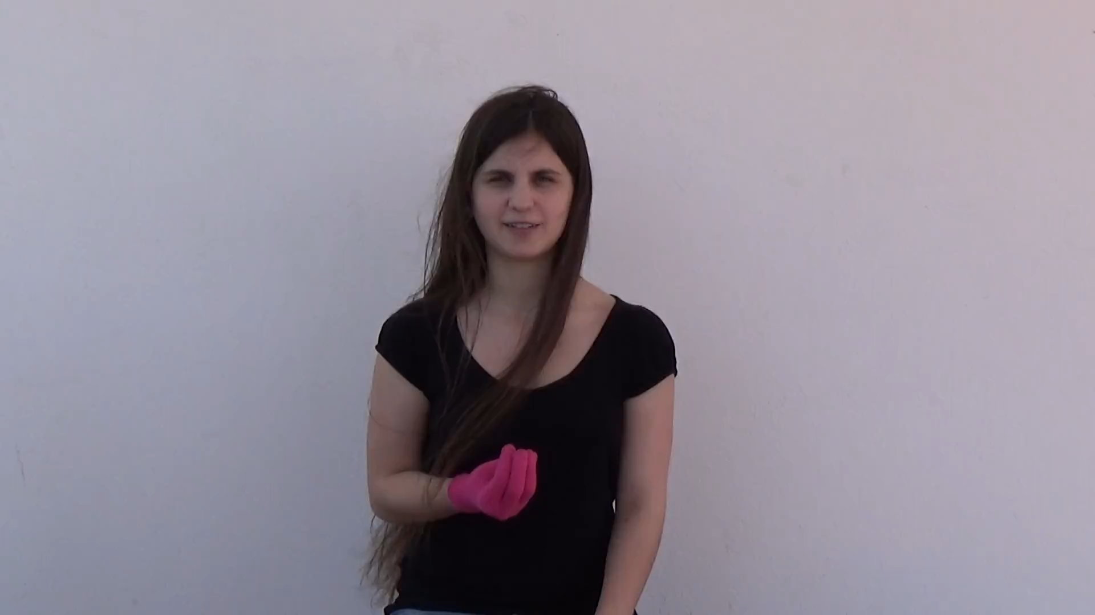
DEMONSTRATION

Slide 20
REFERENCES
Koller, O. et al. (2016) ‘Deep Sign: Hybrid CNN-HMM for Continuous Sign Language Recognition’, Bmvc. doi: 10.5244/C.30.136.
Oliveira, M. et al. (2017) ‘A comparison between end-to-end approaches and feature extraction based approaches for Sign Language recognition’, 2017 International Conference on Image and Vision Computing New Zealand (IVCNZ). IEEE, pp. 1–6.
Keras.rstudio.com. (2019). Inception V3 model, with weights pre-trained on ImageNet. — application_inception_v3. [online] Available at:https://keras.rstudio.com/reference/application_inception_v3.html [Accessed 9 Jan. 2019].
Rathi, D., 2018. Optimization of Transfer Learning for Sign Language Recognition Targeting Mobile Platform. arXiv preprint arXiv:1805.06618.
Canziani, A., Paszke, A. and Culurciello, E. (2016) ‘An Analysis of Deep Neural Network Models for Practical Applications’, pp. 1–7. doi: 10.1002/(SICI)1520-6416(199906)127:4<39::AID-EEJ5>3.0.CO;2-8.
Camgoz, N. C. et al. (2017) ‘SubUNets: End-to-End Hand Shape and Continuous Sign Language Recognition’, Proceedings of the IEEE International Conference on Computer Vision, 2017–October, pp. 3075–3084. doi: 10.1109/ICCV.2017.332.

